Slide 1
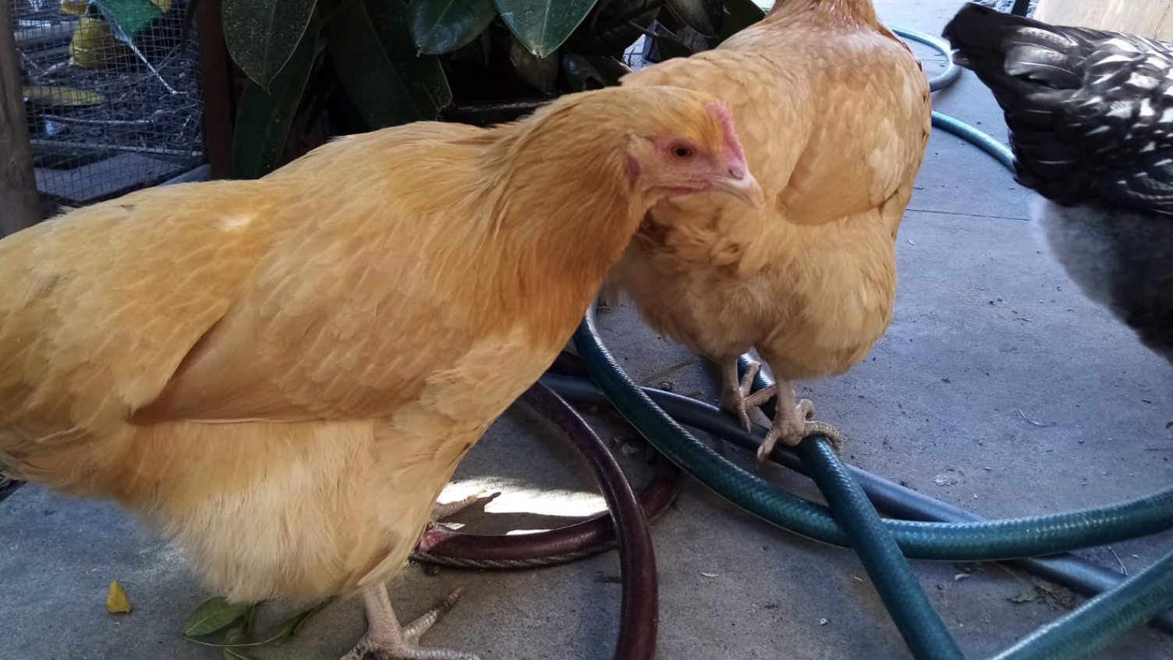
Lab Week Fall 2020 AUTOMATED CHICKEN COOP DOOR

Slide 2
Save The Chickens
An Automated Chicken Coop Door as Protection from Predators at Night
Boris & Daniella Wolf

Slide 3
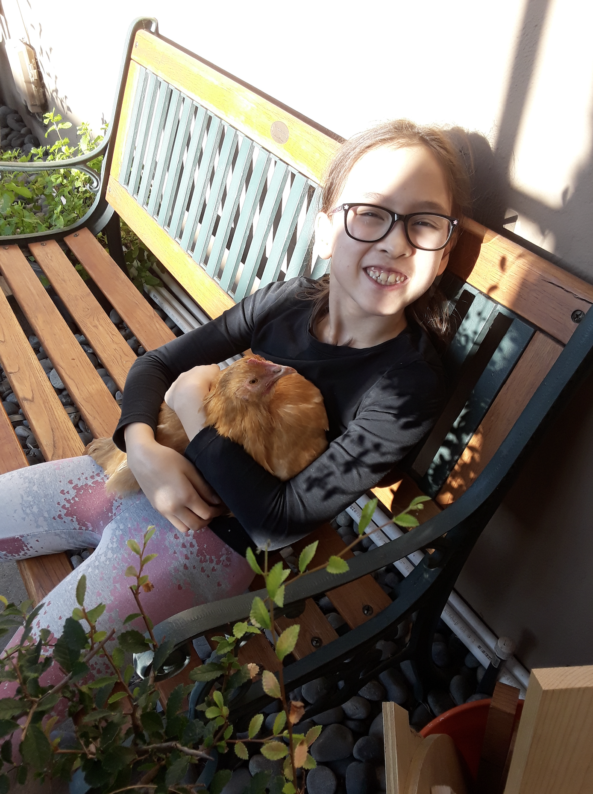
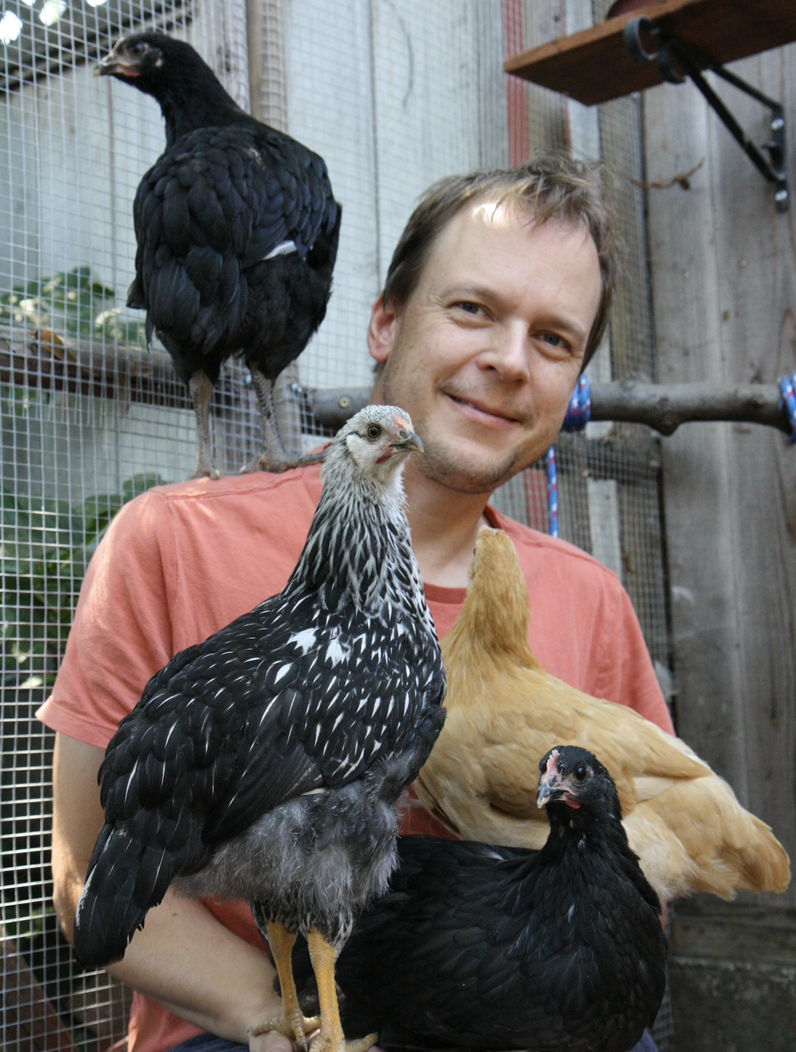
Meet The Team

Slide 4
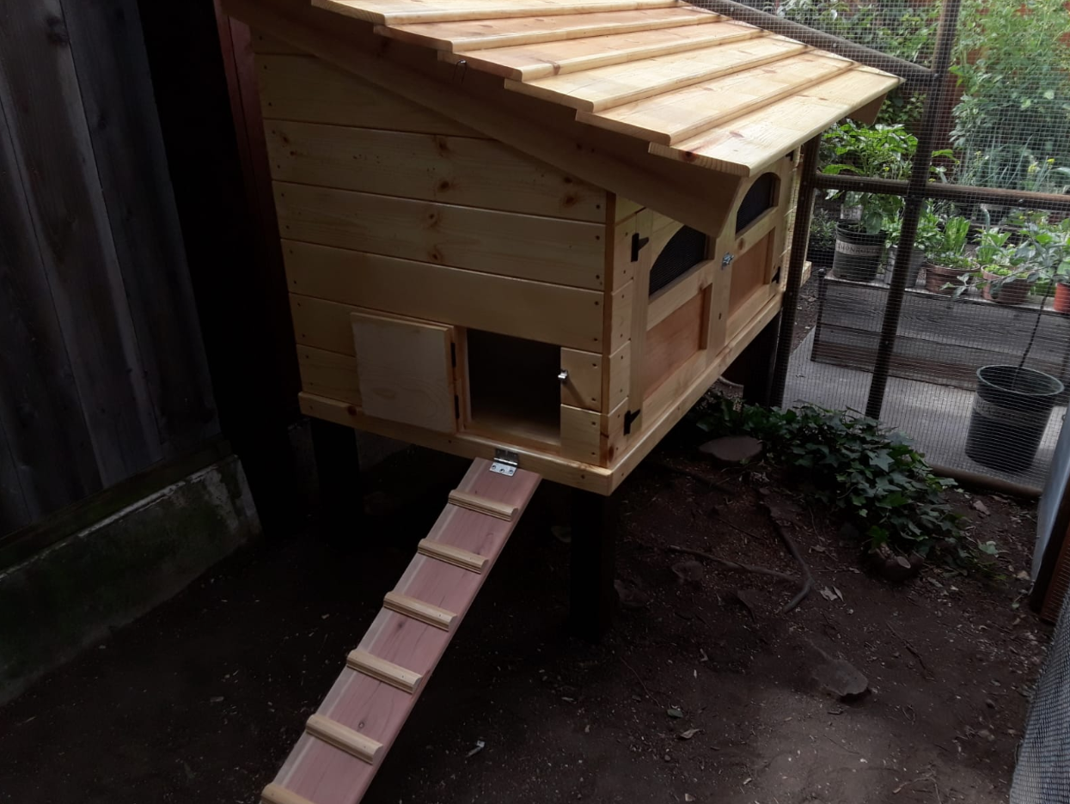
The Chicken Coop

Slide 5
The Chicken Coop

Slide 6
OUTSIDE WORLD
CHICKEN RUN
CHICKEN COOP
DOOR
RAMP

Slide 7
TOTALLY UNSAFE
SOMEWHAT SAFE
VERY SAFE
DOOR
RAMP

Slide 8
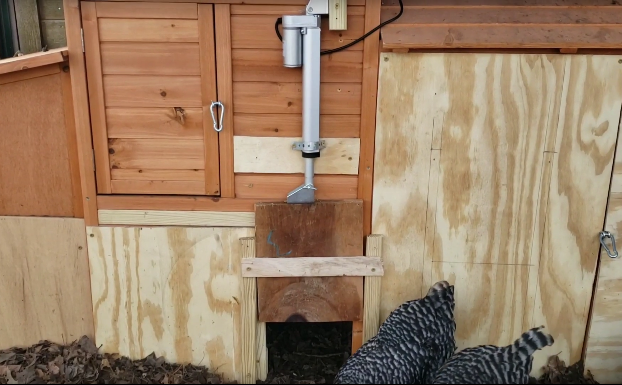
How Others Solved The Problem Linear Actuator

Slide 9
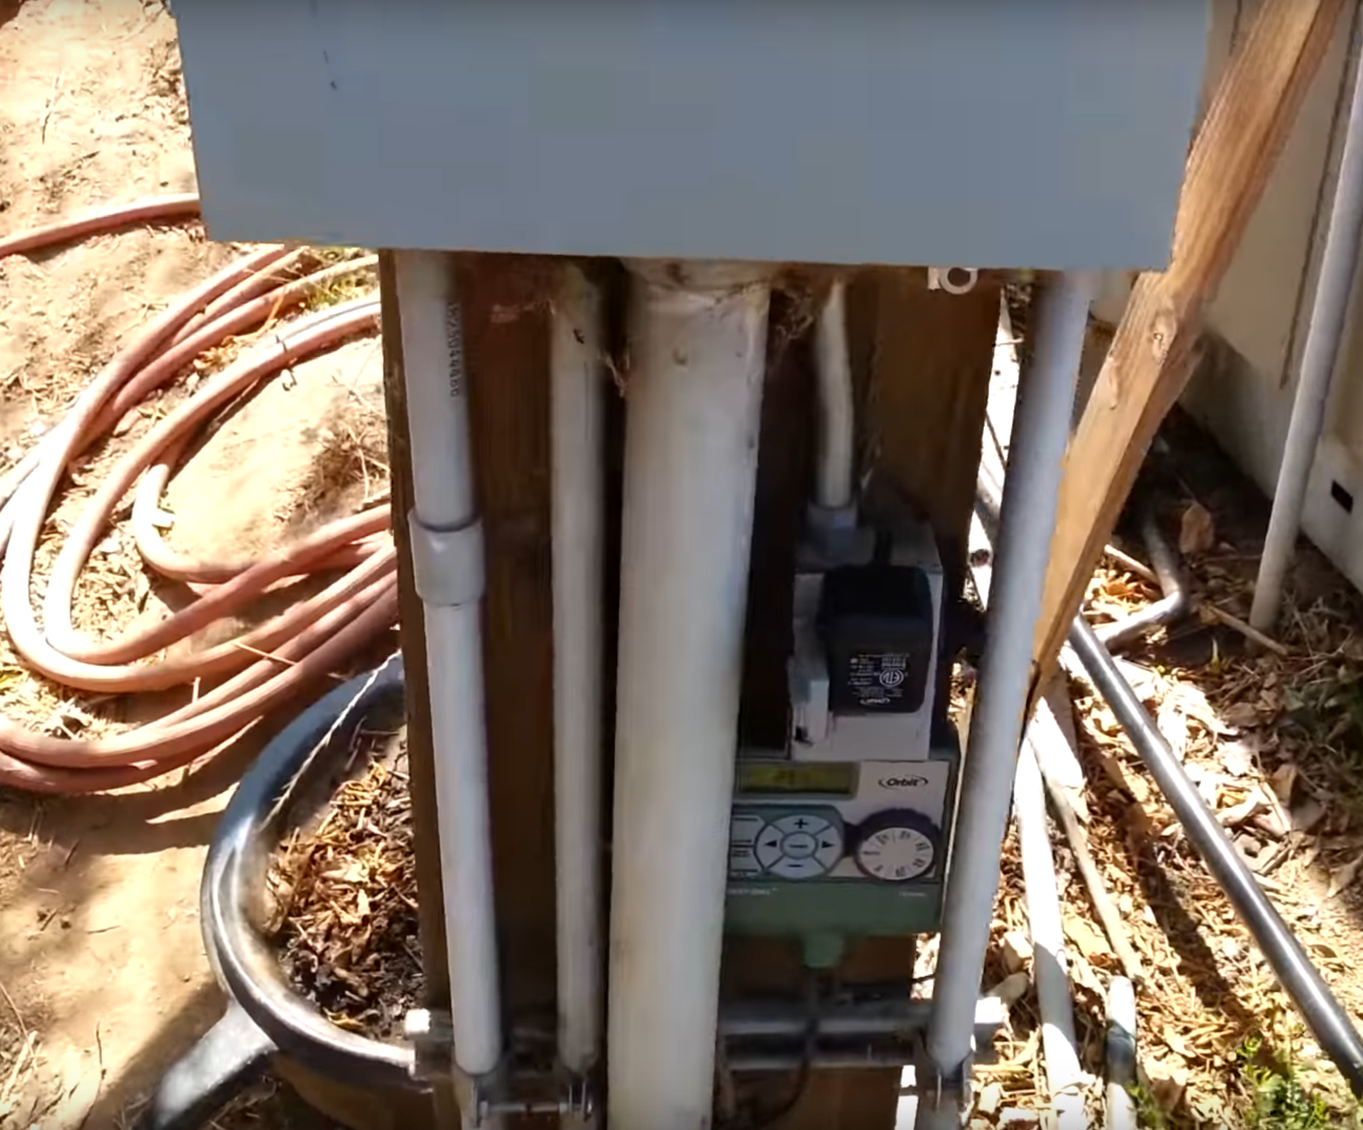
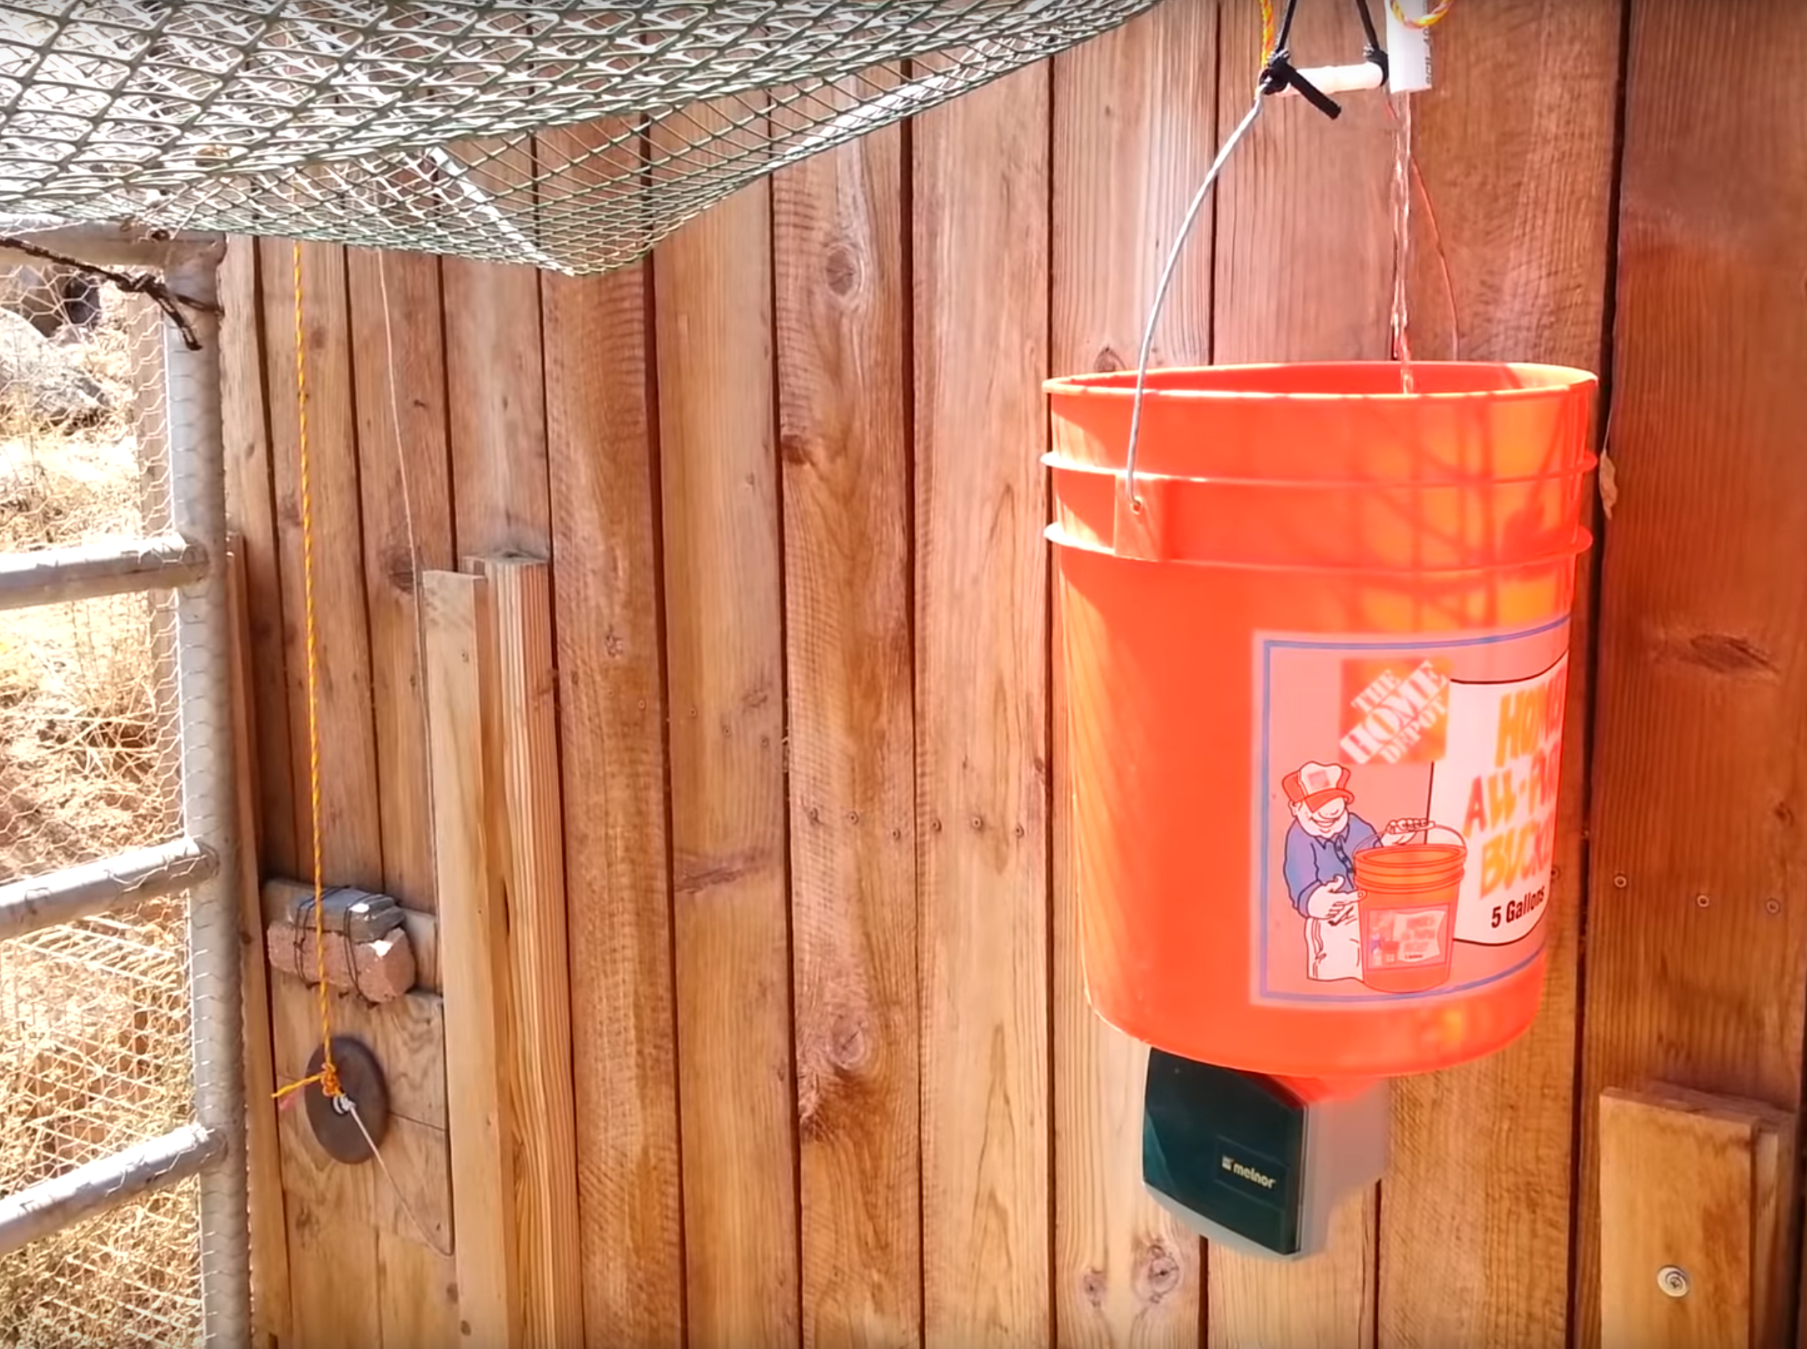
How Others Solved The Problem Water Bucket

Slide 10
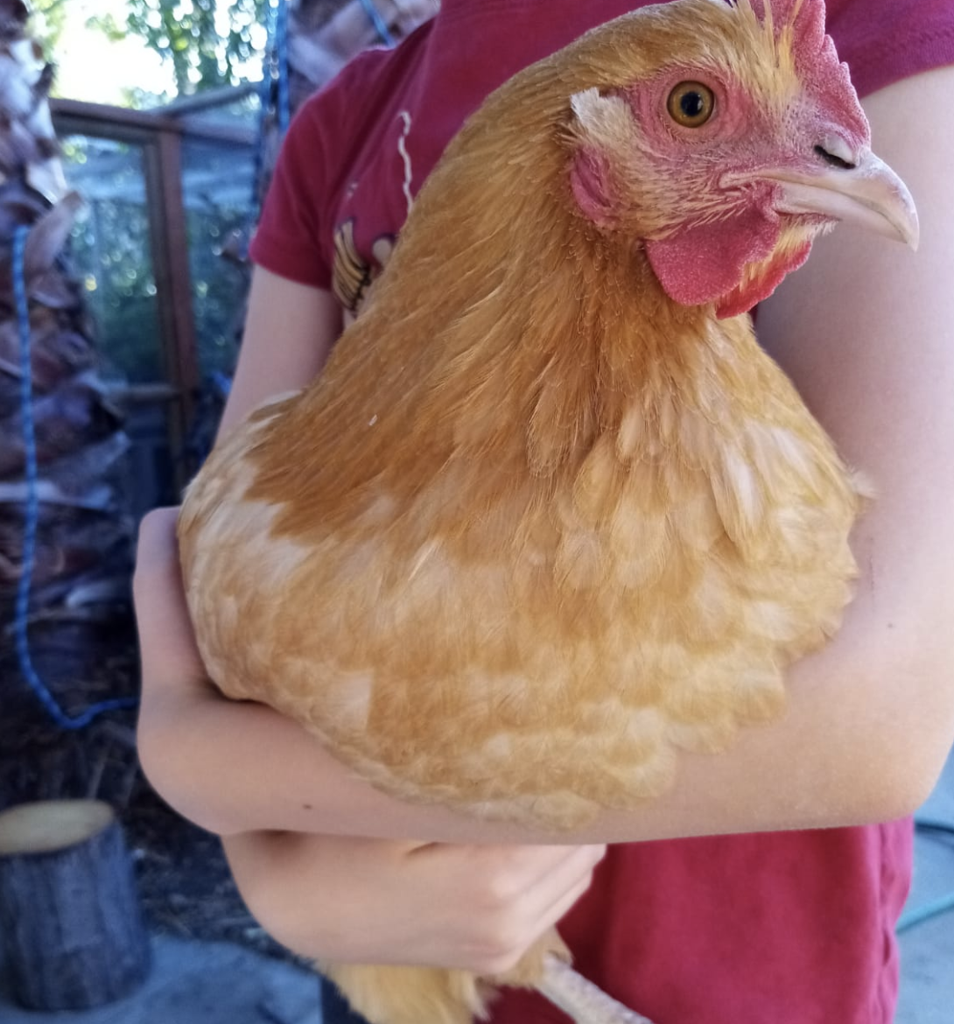
Our Solution Wifi-Enabled Arduino Uno
Mechanical System
Electrical System
Software

Slide 11
Our Solution
Mechanical System
Motor can lift and lower door
Gravity based self-locking mechanism
Electrical System
DC Motor
Arduino Uno Wifi Rev 2 as microcontroller
H-Bridge
Magnetic Sensor (Reed Switch) to detect door position
Photo Resistor to detect night and day conditions
Kill Switch to shut off motor in case of door malfunction
Software
Arduino Sketch featuring a simple web app for remote control

Slide 12
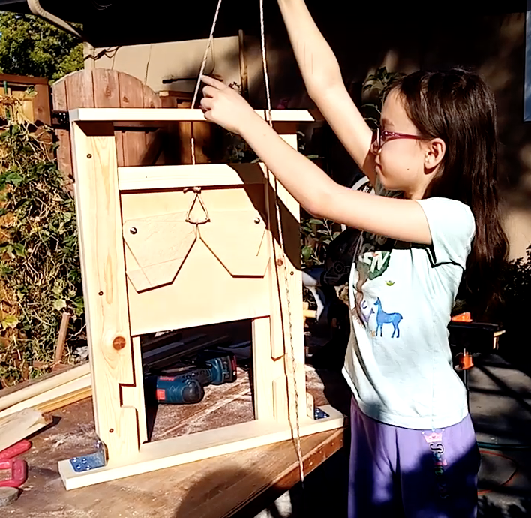
Mechanical System

Slide 13
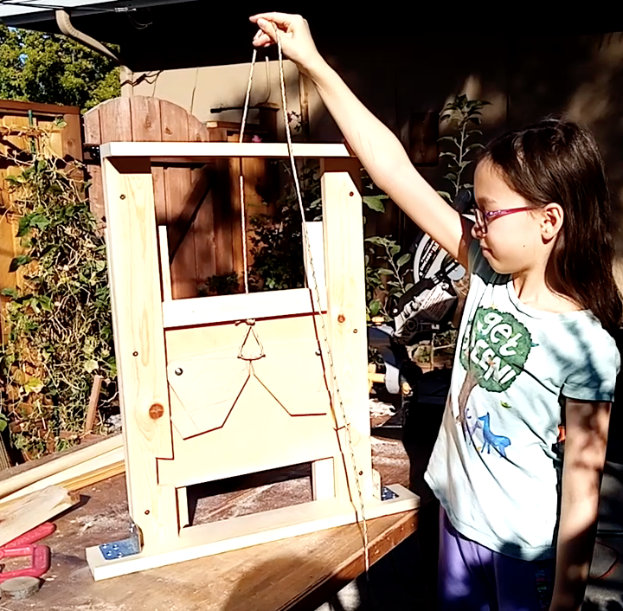
Mechanical System

Slide 14
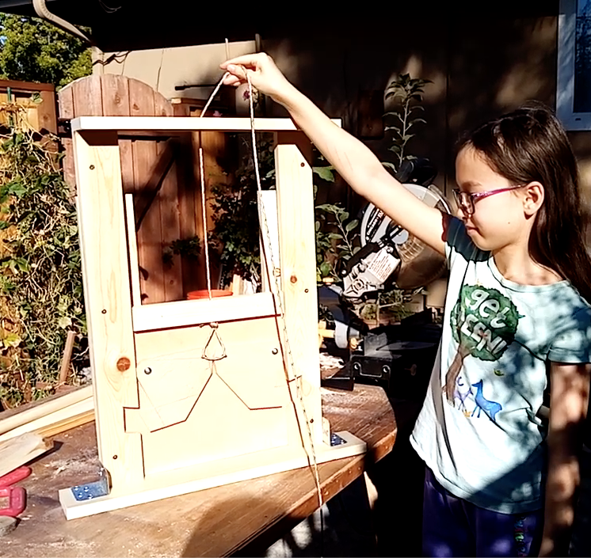
Mechanical System

Slide 15
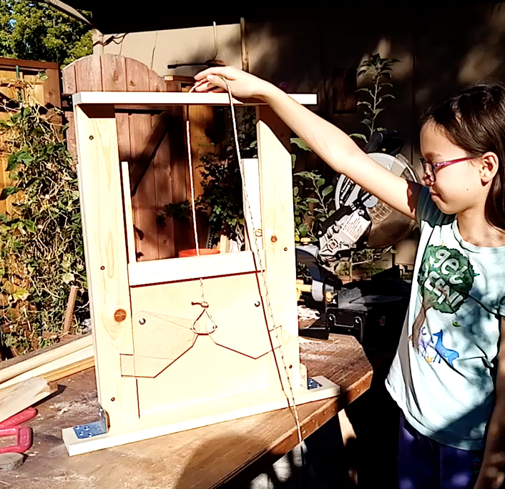
Mechanical System

Slide 16
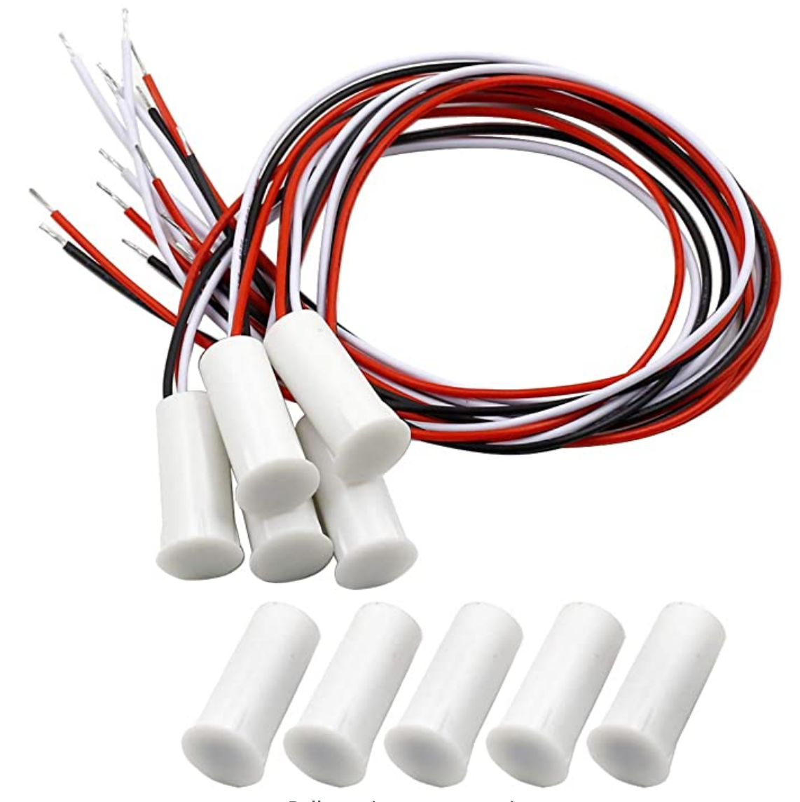
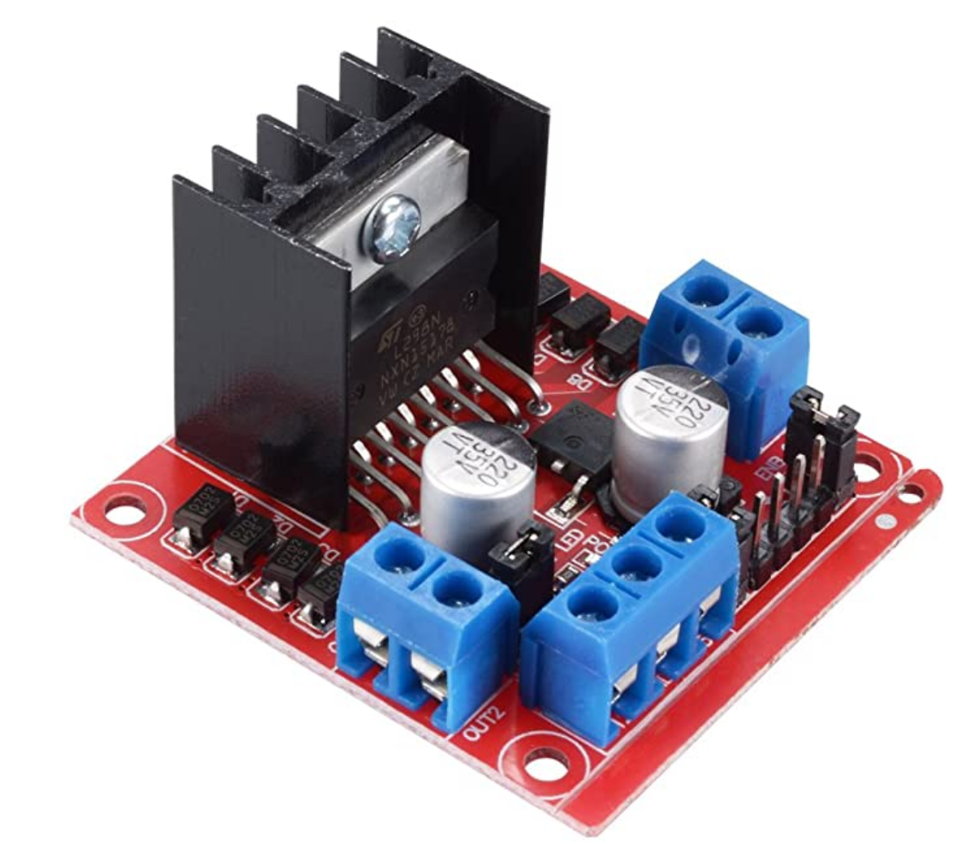
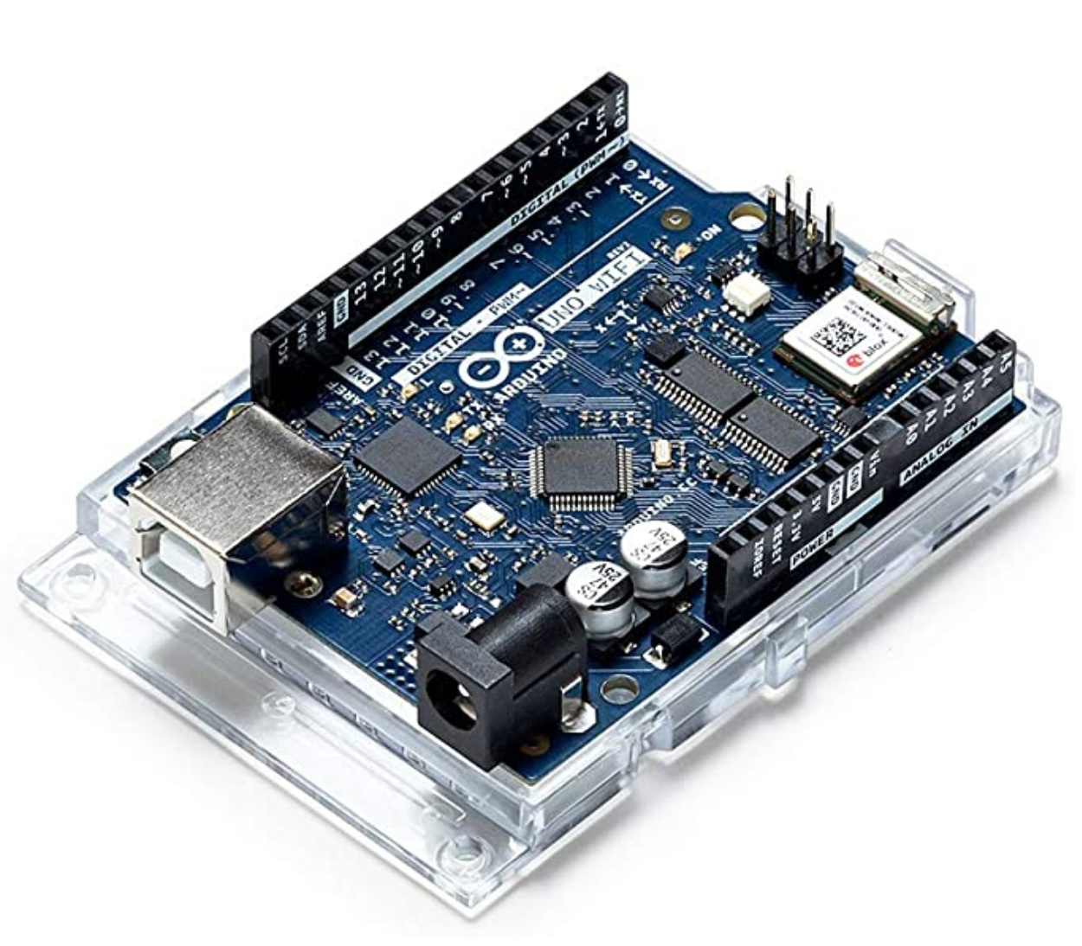
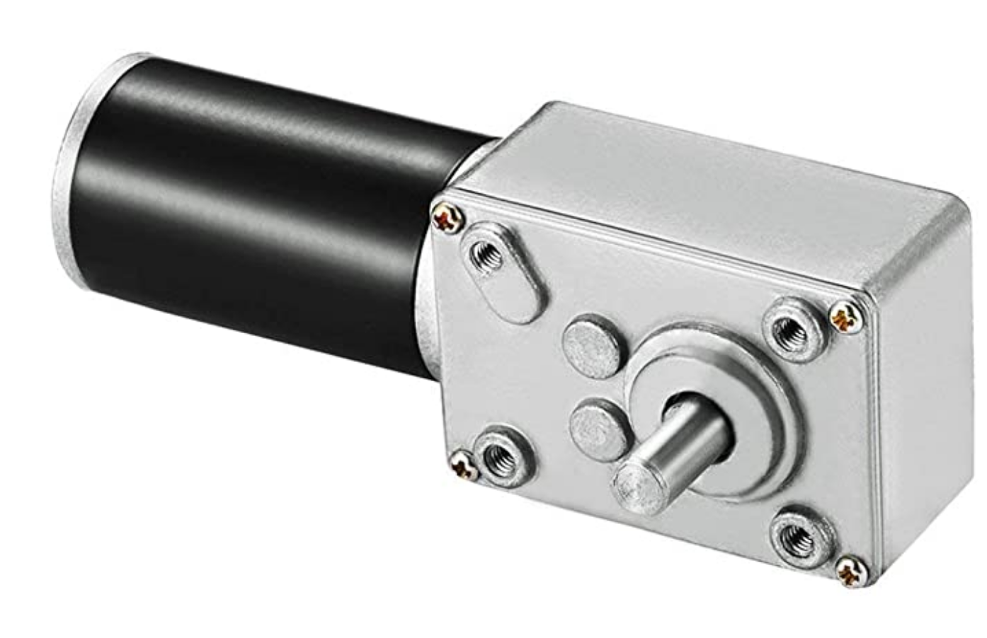
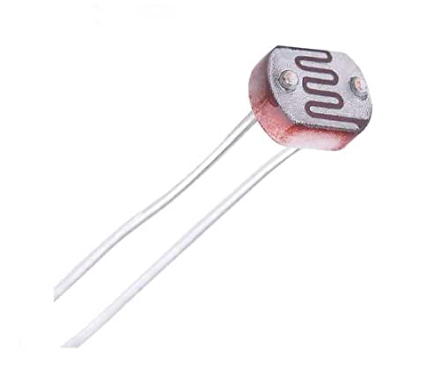
Electrical System

Slide 17
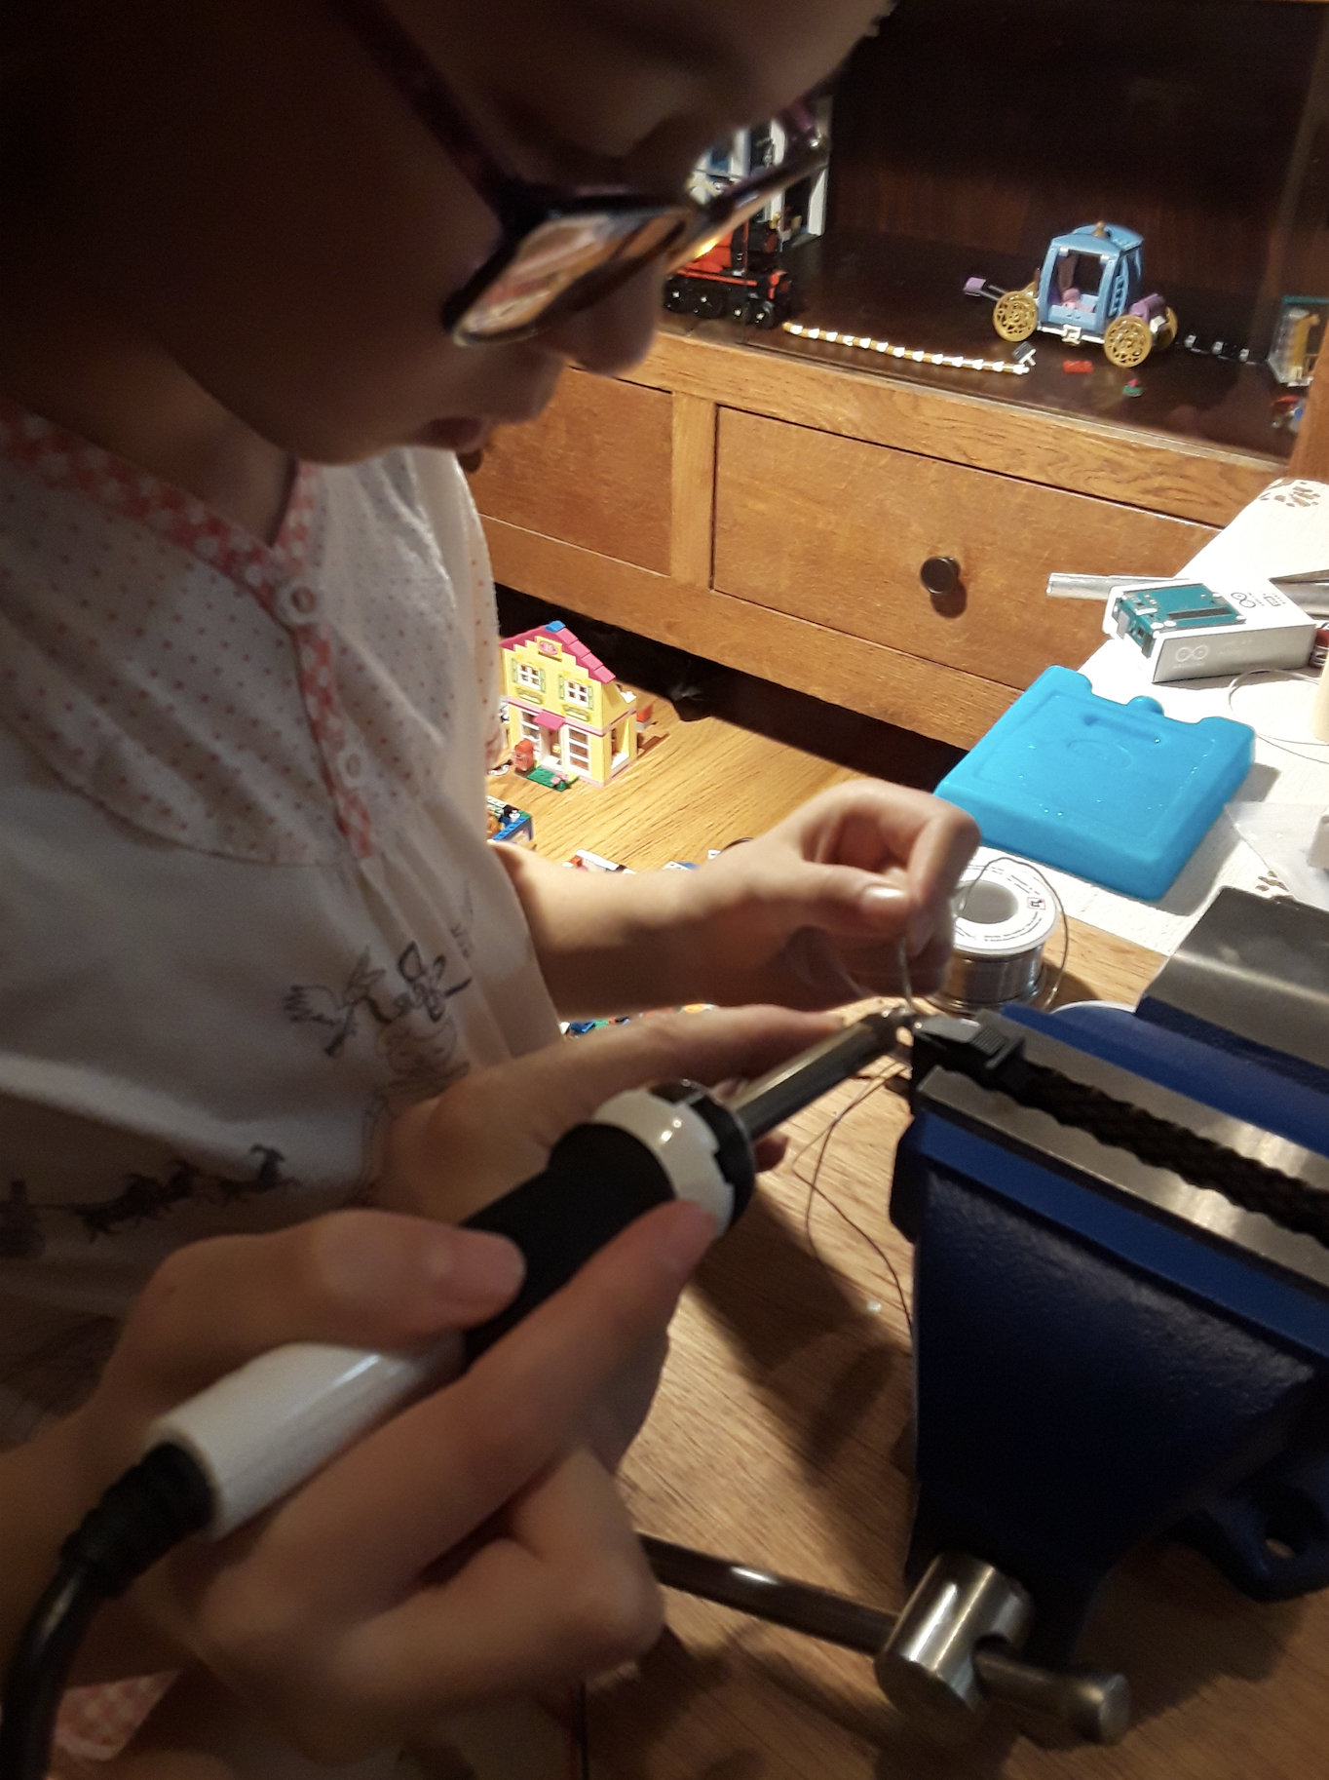
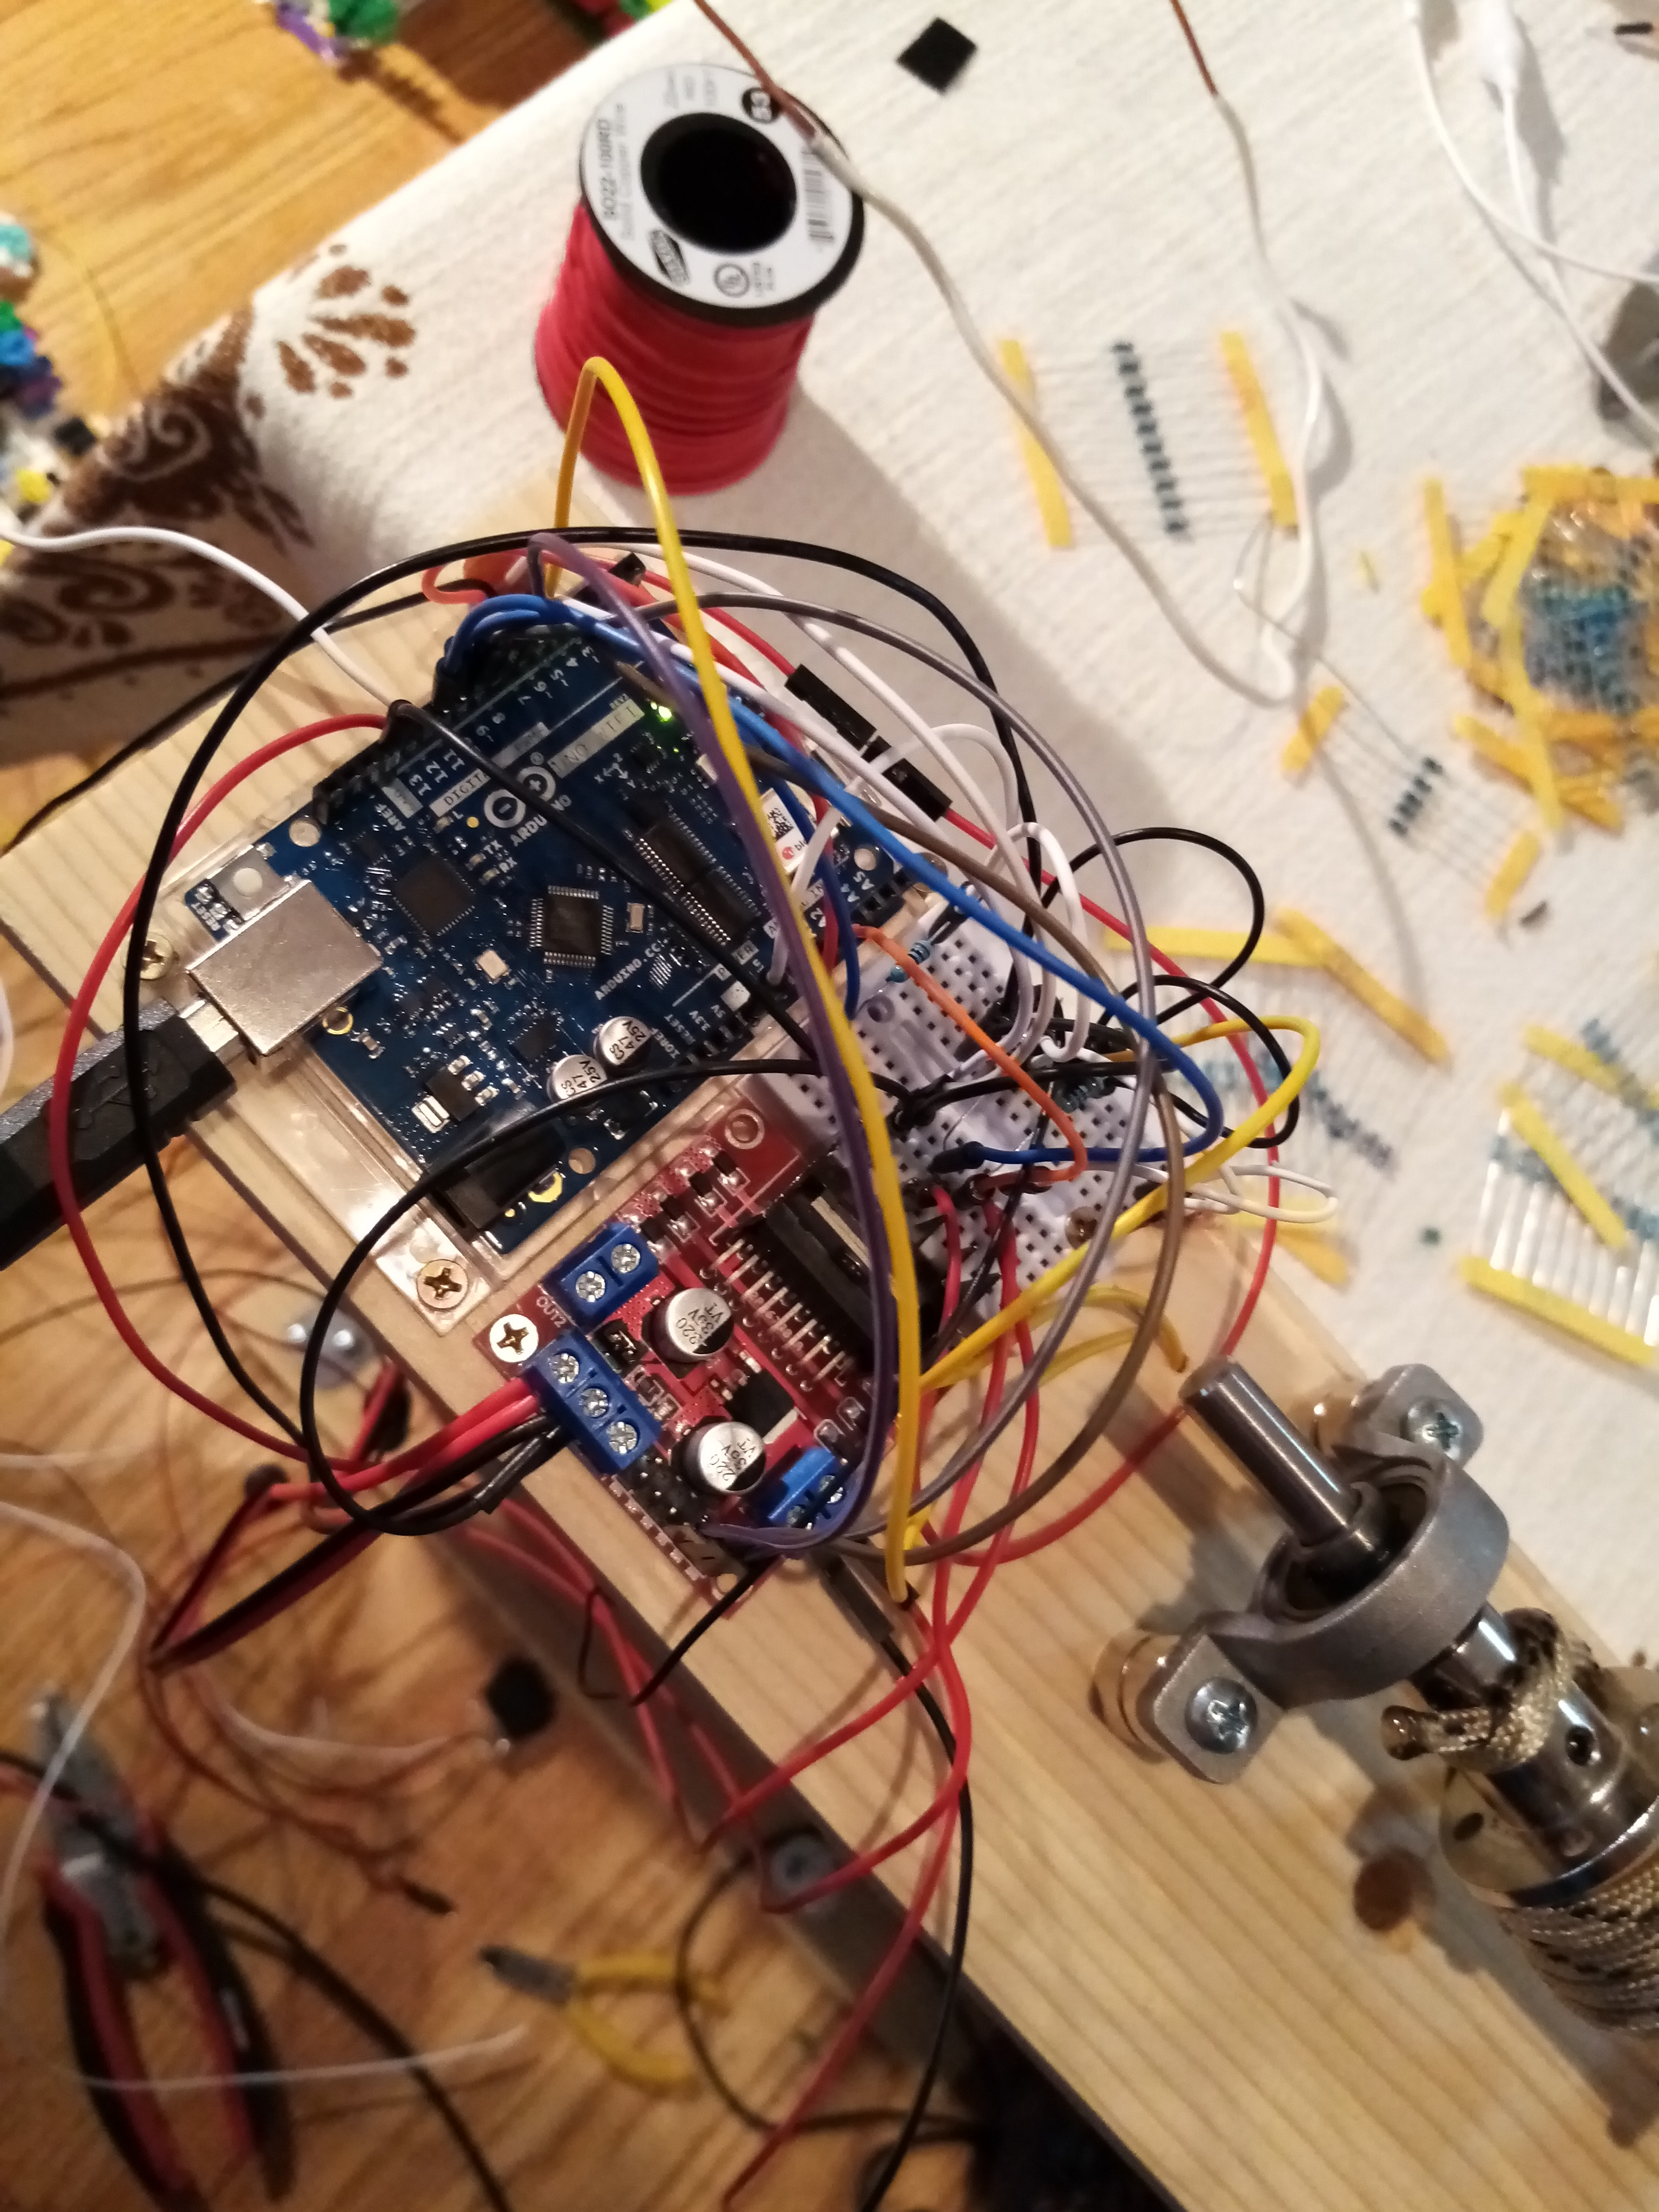
Electrical System

Slide 18
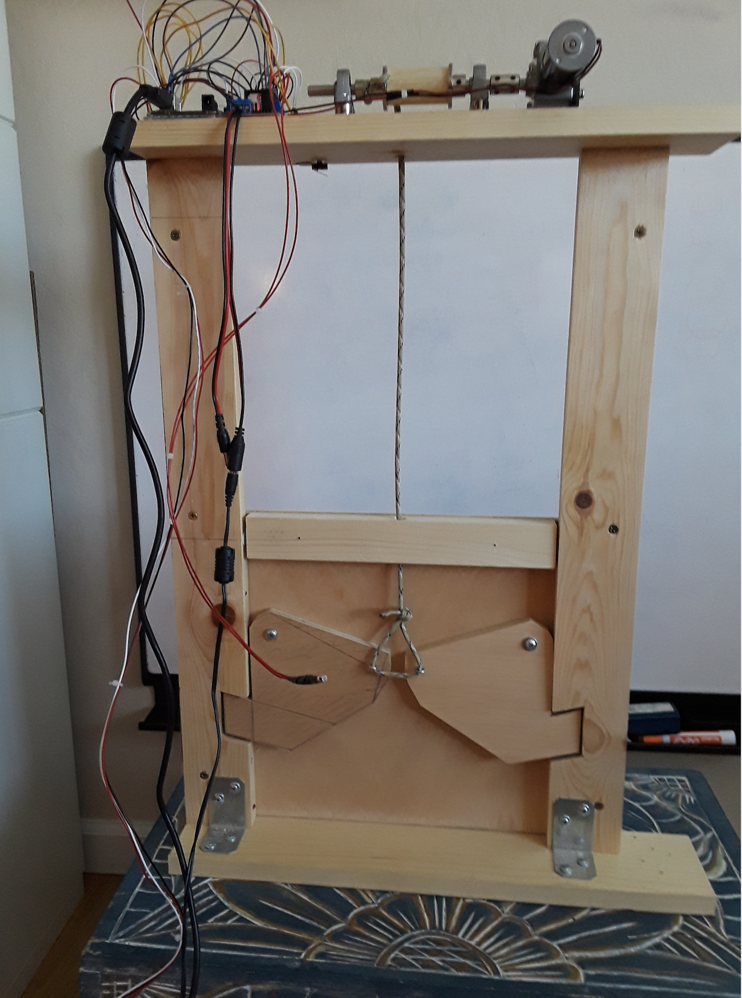
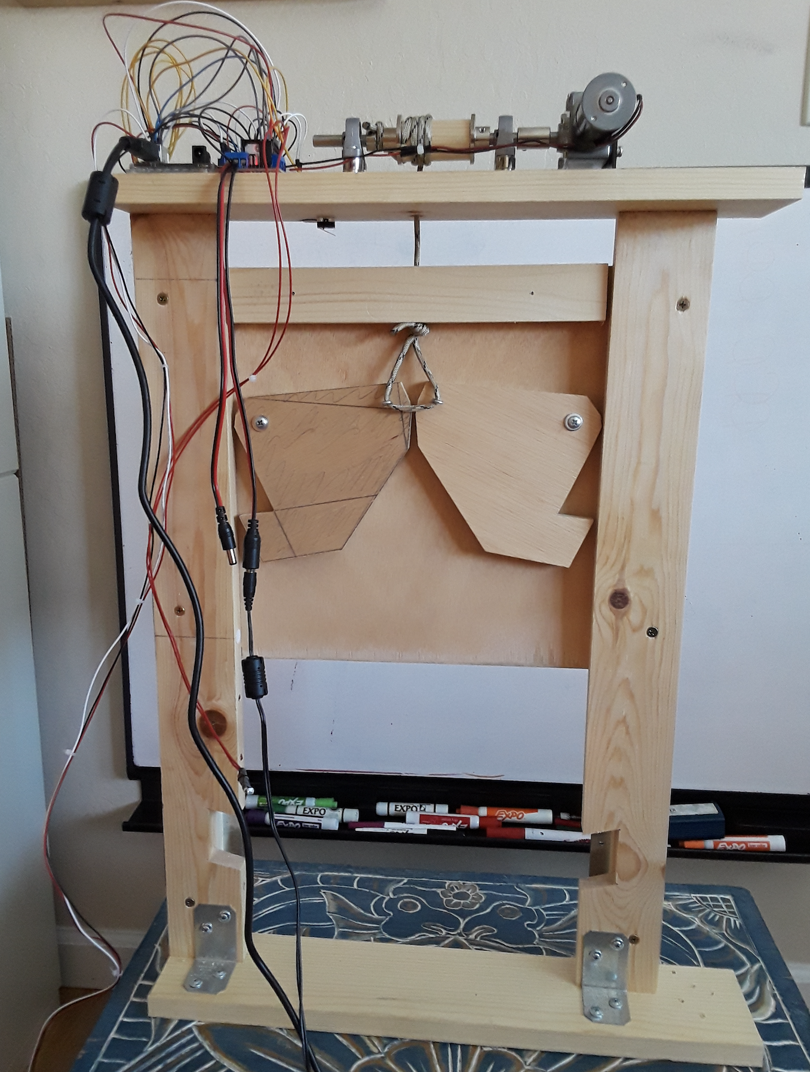
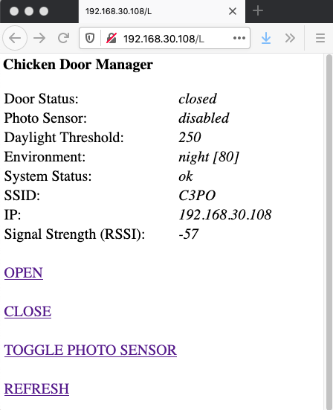

Slide 19
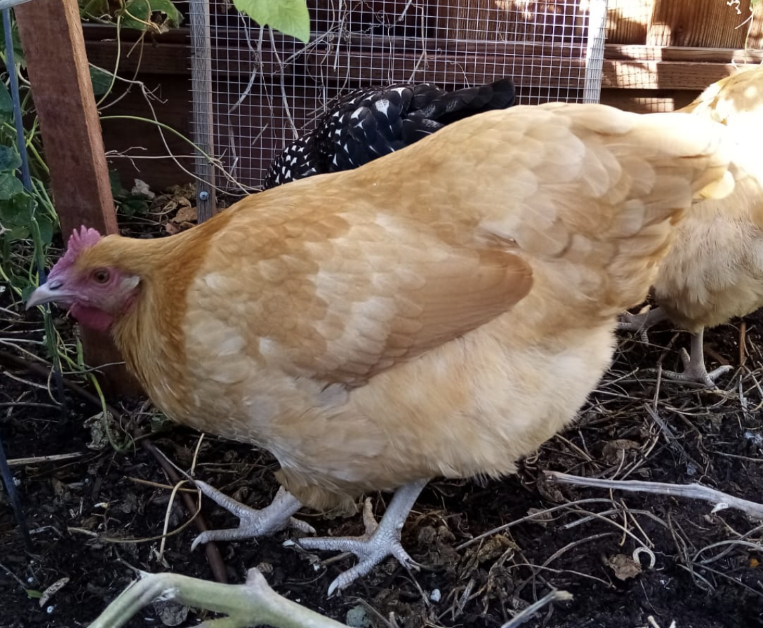
Modes of Operation
Light Based: Open the door after sun rises, close door after sun sets
Timer based / scheduled
Remote via Web Browser / Wifi
Manual override (local)

Slide 20

Was It Worth It? ☺
Time it takes to open coop door manually (twice a day):
1 min
Time it took to build automated door:
40 hours
Break even after:
3.3 years

Slide 21
Continued Work
Install door in coop
Fine tune light based operation
Solar panel + rechargeable battery

Slide 22
THANK YOU

